Slide 1
Setting Up and Training a Model
Set Up a Machine Learning Model
Train the Model

Slide 2

SET UP a Machine Learning Model

Slide 3
Design of Experiments
Problems addressed through machine learning
May be too complex to accomplish through traditional computer programming methods
Are typically solved through a process of systematic experimentation
Design of Experiments (DOE, DOX, or Experimental Design) approach
Used by data analysts, medical researchers, and others
Begin with a hypothesis
Change variables you can control to see their impact on variables you can't directly control
Variables you can control—Also called independent variables, input variables, predictor variables
Variables you don't control—Also called dependent variables, output variables, response variables
Through this type of experimentation, you might:
Determine which combination of independent variables will produce the best model for your needs
Select the best machine learning algorithm for your needs
Adjust settings of the learning algorithm to optimize its performance

Slide 4

Hypothesis
Hypothesis: (Machine Learning) A candidate machine learning model that you create to test its performance, particularly whether it is able to produce the outcome that you require.
Program the hypothesis to generate a function that produces the intended outcome.
Use the hypothesis for additional investigation, experimentation, and evaluation.
Improve upon the hypothesis through experimentation.
Train the hypothesis using a sample of historical data, which produces a model.
Test the model’s performance by trying it out on new data and evaluating results.
Refine the model through experimentation.
The finished solution is the target function, which you can use to find output data (answers) for inputs to real problems.

Slide 5
Hypothesis Testing
Part of machine learning is selecting the best model for the task.
You'll have to choose one model over others.
Usually the one with best estimated effectiveness when making predictions.
Effect could be real, or it could be due to statistical chance.
Hypothesis testing helps you determine which.
Focuses on null hypothesis (assumes no difference between models).
You may not have sufficient evidence to reject null hypothesis.
You may have sufficient evidence to reject null hypothesis.
Example: You train two models on same data; one model removes a feature.
Reduced model gives better result.
However, improvement may be due to probabilistic nature of algorithms.
You need to test the models to see if the difference is real (i.e., reject null hypothesis).
If you can't reject null hypothesis, you can't be confident the reduced model is truly better.

Slide 6
Hypothesis Testing Methods (Slide 1 of 2)
Testing Method | Description
A/B test | Compares two values of same variable to determine most effective. Example: Serving two different pages to customers to see what works best. Null hypothesis: Adding an extra UI widget has no effect on conversion rates.
z-test | Compares mean of two distributions. Population standard deviation is known. Example: Mean exam score is 76; sample of 40 students has a mean of 78. Null hypothesis: Selected students have comparable exam scores to random sampling of students. Most applicable when sample size > 30.
t-test | Compares mean of two distributions. Population standard deviation is not known. Most applicable when sample size < 30.

Slide 7
Hypothesis Testing Methods (Slide 2 of 2)
Testing Method | Description
ANOVA | Compares mean of three or more distributions. Example: Test treatment on sample groups of patients. Null hypothesis: Treatment has same effect on all groups. Minimizes errors as compared to doing multiple t-tests.
Chi-squared test | Compares effect of categorical variables. Example: Does berry color affect whether or not it's poisonous? If yes, variables are dependent. Null hypothesis: Variables are independent.

Slide 8
p-value
p-value: The probability of getting a result from a test given a true null hypothesis.
Helps you determine whether or not to reject null hypothesis.
Based on if value is lower or higher than specified level of statistical significance.
Level of significance is alpha value.
Determined beforehand.
No "correct" value, but 0.05 is common.
Compare p-value to alpha:
If p-value > alpha, fail to reject null hypothesis.
If p-value <= alpha, reject null hypothesis.
Example: If p-value is 0.03, and alpha is 0.05, you reject null hypothesis.
p-value is not probability of null hypothesis being true or false.
Also doesn't definitively tell you which.
Provides you with a level of confidence instead.

Slide 9
Confidence Interval
Confidence Interval: A measurement that returns a range of values for which there is some specified probability that the true value lies within that range.
Specified probability is confidence level.
95% is common.
95% probability that range of values will contain true value.
Example: Interval is (10, 30) for range of mean values.
95% chance that true mean value is not less < 10 or > 30.
Unlike p-value, confidence intervals can show likely effects on population.
If value is outside interval, you can be confident it doesn't exist in population.
Confidence interval and p-value can be used together.
Both can play a part in deciding whether or not to reject the null hypothesis.

Slide 10
Machine Learning Algorithms
Learning mode
Outcome
Use Case Examples
Algorithm Examples
Regression
Weather forecasting
Market forecasting
Predicting life expectancy
Linear Regression
Decision Tree
Support-Vector Machine
Random Forest
k-Nearest Neighbor
Supervised
Classification
Identity fraud detection
Image classification
Diagnostics
Logistic Regression
Clustering
Recommender systems
Targeted marketing
Customer segmentation
k-Means Clustering
Hierarchical Clustering
Machine Learning
Unsupervised
Dimensionality Reduction
Big data visualization
Structure discovery
Feature elicitation
PCA/t-SNE
Reinforcement
Real-time decisions
Robot navigation
Learning tasks
Q-Learning
SARSA
DQN

Slide 11
Algorithm Selection
Can seem overwhelming.
There are numerous supervised and unsupervised machine learning algorithms, each one employing its own approach to the learning process.
The "right" algorithm depends on the situation.
More than one algorithm can solve a particular problem.
Even highly experienced data scientists may not be able to immediately select the best algorithm for a particular situation without some experimentation.

Slide 12
Factors that Guide Evaluation of a Machine Learning Model
How well the model meets use cases and other requirements
How much preprocessing is required
How effective the model is
How explainable the model is
How long it takes to build a model
How long it takes to make predictions using the model
How well the model can scale to handle expected quantities of data

Slide 13
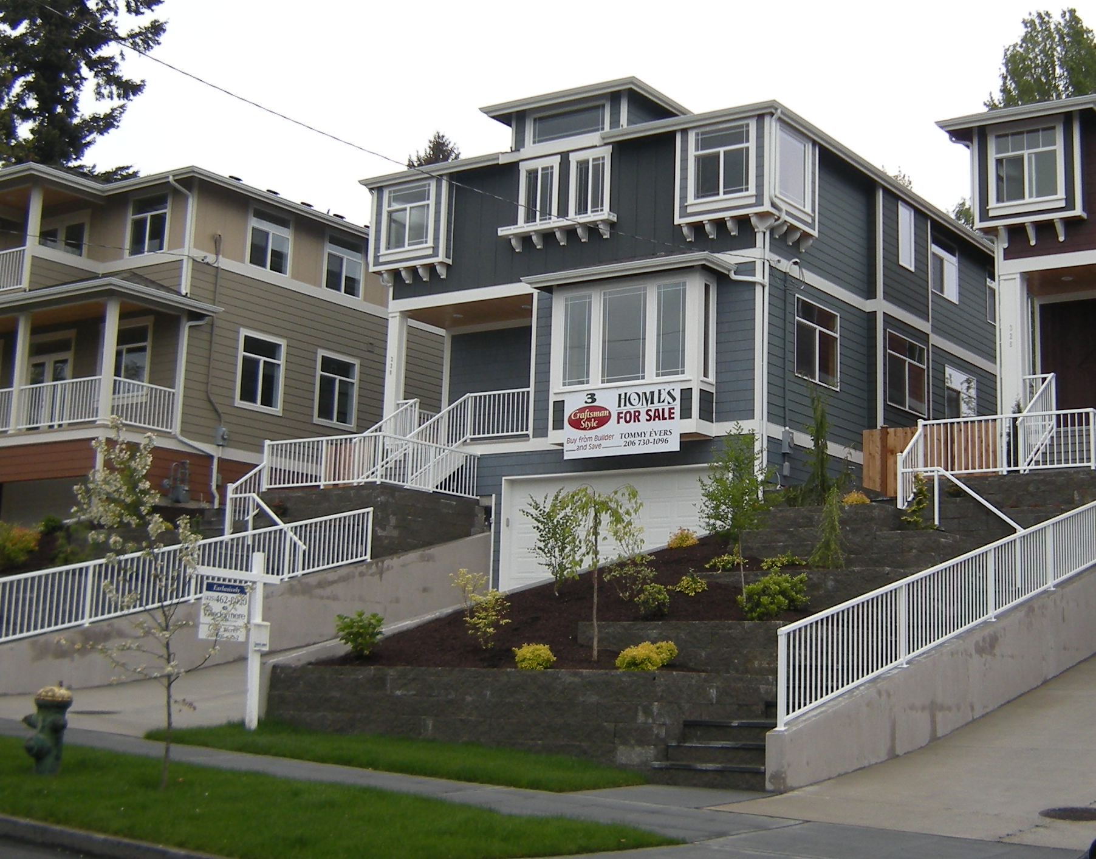
Activity: Setting Up a Machine Learning Model
You have analyzed the real estate dataset.
You are now ready to create a machine learning model for the real estate price estimator.
This first pass is your hypothesis, which you will use for experimentation and testing.
You will start by setting up a linear regression model.
Question: Why would you use a linear regression algorithm to produce a real estate price estimator?

Slide 14
Train the Model

Slide 15

Iterative Tuning
Machine learning models:
Require that you attend to challenges that will lead to ineffective and faulty results.
Are probabilistic, based on variance in the data.
Are improved by using different samples for training and testing to reflect the types of challenges the model will encounter when used with real data.
Are tested over multiple iterations. You make refinements, and test again.
In statistics, it is often said that "all models are wrong—but some are useful."
Models will always contain some degree of error, due to variations based on probability.
The goal is to produce a model that is correct enough as to be useful, even though the predictions may not be exactly correct or always correct.
Skillful
A model that is useful for its intended task.
There are degrees of skill; some models are more useful than others.
Improving a model's skill is the ultimate goal of the iterative tuning process.
TUNING
PRECISION
RECALL

Slide 16

Bias
A systematic error in data analysis that results in a faulty model.
Selection bias
Reporting bias
Attrition bias
Data snooping bias

Slide 17
Compromises
Often required when tuning a model
Finding the “sweet spot” that results in a model that meets business requirements
For example, you might compromise some of the model’s skill in favor of:
Simplicity of the data pipeline
Model interpretability
Resources needed to train and operate a model

Slide 18
Model Generalization
Model Generalization: When a machine learning prediction model is able to make a reasonably good prediction on any new datasets that it might encounter—beyond the dataset that was originally used to train it.
Overfitting
Tuning the model to very closely match the unique data in the training dataset.
Prevents the model from generalizing well to new datasets.
Can be avoided or resolved if you:
Work with a larger sample of data.
Use regularization to reduce some of the model's sensitivity to noise—for example, by using a simpler model with fewer parameters or using fewer attributes in the training data.
Clean and prepare the data better to reduce noise in the data itself.

Slide 19
Cross-Validation
Provides a way to estimate how well the model performs
Hasn't been overfitted
Hasn’t been underfitted
Not influenced by noise in the data
Works well with new datasets
Also called rotation estimation or out-of-sample testing
Measures how well the model is able to generalize
Techniques:
The holdout method
k-fold cross-validation
Stratified k-fold cross-validation
Leave-p-out cross-validation

Slide 20
k-Fold Cross Validation
The process is repeated k number of times:
Data is split into k groups (folds), using one as the test set and the rest as the training set.
The model trains and then evaluates its performance.
The groups rotate, using a different group as the test set, and the rest as the training set.
The average error across all of these trials is calculated.
This approach:
Minimizes variance, as every data point is used to both train and test at some point.
Adds overhead to both time and processing power.
A practical rule of thumb is to set k between 5 and 10.
Stratified k-fold cross-validation:
Helps to minimize variance and bias issues by ensuring that each train/test fold is a good representation of the data as a whole.
In binary classification, if 30% of the data is in class 1 and 70% is in class 2, then 30% of the data in each fold will be in class 1, and 70% will be in class 2.
Is most suitable in cases of class imbalance.

Slide 21
Leave-p-Out Cross-Validation (LPOCV)
Essentially the k-fold method, but with k equal to all data points in the set (n).
n − p data points are used in training
p data points are used to test
Repeated for all possible combinations of data that fit this split.
Like with k-fold, the average error across these trials is then calculated.
Leave-one-out cross-validation (LOOCV)
Leaves p at 1, because as p increases, the amount of trial combinations increases dramatically, leading to significant performance issues.
Commonly used to minimize bias in smaller datasets.
May not perform well with larger datasets due to increased variance and performance concerns.

Slide 22
Activity: Dealing with Outliers
Outliers:
May mislead the algorithm and hinder the fit.
Can be corrected or dropped from the dataset to improve the model.
price and bedrooms:
Showed a lot of white space on the right side of their histograms.
Should be investigated to see if they have outliers in the high end of the range.

Slide 23
Feature Transformation
Items represented using similar numbers are easier to compare.
Example: age and income
Very different ranges of values
Could be scaled for easier comparison so the maximum age and income are both 1
Someone with an average age and income: values near .5 for both
Young person with a high income: Age less than .5 and income near 1
Refer back to original data values to determine the actual age and income
In some cases it can help to adjust the way data is distributed.
Skewed distributions:
Are common in real world data
Make it cumbersome to perform statistical analysis
Mathematical transformations:
Can be applied to data to remove skew and normalize the scale
Facilitate data analysis—not only by humans, but by machine learning algorithms as well
Can make some patterns in data more evident, improving the algorithm's performance

Slide 24
Transformation Functions
Can be used to transform features.
Should be chosen based on circumstances.
Examples
Normalization:
Scales data items to fit within a range such as 0 to 1.
Various methods may be used, but can be obtained through division.
May leave the distribution skewed.
Log:
Obtained by calculating the log base 10 of x, log base e of x (ln(x)),or log base 2 of x.
Reduces skewness.
Can be used only on positive numbers.
Cube Root:
Obtained by raising each data item to a power of 1/3.
Reduces skewness, but not as strongly as a log function.

Slide 25
Activity: Scaling and Normalizing Features
You are continuing with your optimization of the model, looking for additional problems with the training data.
You will look for data values that should be adjusted to produce a better linear regression model.

Slide 26
The Bias-Variance Tradeoff
High Bias
May underfit the training set
More simplistic
Less likely to be influenced by true relationships between features and target outputs
The Sweet Spot
Good enough fit on training datasets
Just complex enough
Skillful in finding true relationships between features and target outputs while not overly influenced by noise
High Variance
May overfit the training set
More complex
More likely to be influenced by false relationships between features and target outputs (“noise”)
The Sweet Spot
Error
Total Error
Variance
Bias
Model Complexity

Slide 27
Parameters
Configurable values that control the machine learning process
Model parameters
Derived from the machine learning model as it undergoes training
Actually "learned" by the model while it performs calculations on the training data
Determine how well the model makes predictions and other intelligent decisions
Typically configured by the algorithms and mathematical functions that comprise the machine learning process
Hyperparameter
Set on the algorithm itself and not the learning model
Typically configured by the machine learning practitioner, before training
Used by the practitioner to tune the model

Slide 28
Regularization
1
Unregularized model
Regularized model
House Price ($M)
0
0
10
House Size (K ft²)

Slide 29
Models in Combination
Try different types of algorithms that produce the type of outcome you require.
Tune them and compare their performance.
Select one that performs the best or best meets your requirements.
In some cases best results are achieved using multiple algorithms in combination, processing the data in stages.
For example:
Use one algorithm to perform dimensionality reduction on the dataset.
Use another algorithm to make predictions.

Slide 30
Processing Efficiency
Time your processing hardware (CPUs and GPUs) requires to train and run a model:
May not be much of a concern with small datasets
Real world datasets can be huge and complex, taking hours or even days to be processed
More capable hardware may be part of the solution.
But it's easy to waste money on hardware that is not necessary, when you can improve efficiency through other means.

Slide 31
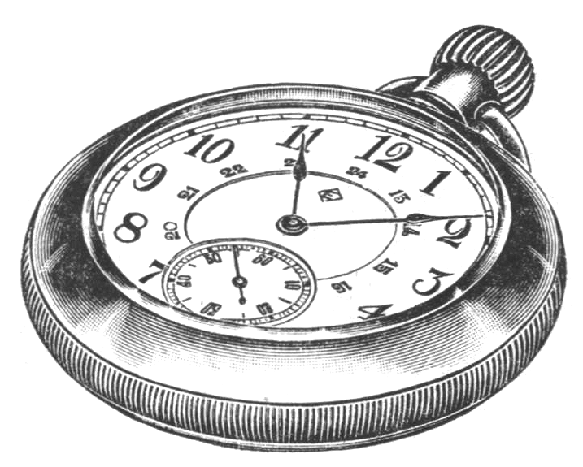
Manage the Time Needed for Processing
Set realistic performance requirements.
Avoid unnecessary complexity.
Employ appropriate math and logic techniques.
Learn through experimentation.
Select the right hardware.
Improve the structure of your datasets.

Slide 32
Activity: Refitting and Testing the Model
You will now test the model again, to see whether the adjustments you made to the datasets will improve the results.

Slide 33
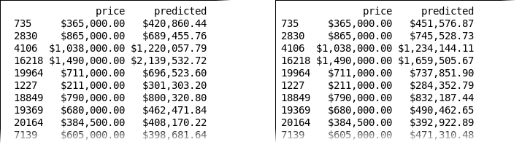
Round Two Improvements
Round One Predictions
Round Two Predictions

Slide 34
Random Forest
Learning mode
Outcome
Use Case Examples
Algorithm Examples
Regression
Weather forecasting
Market forecasting
Predicting life expectancy
Linear Regression
Decision Tree
Naive Bayes
Support Vector Machine
Random Forest
AdaBoost
Gradient Boosting Trees
K-Nearest Neighbor
Supervised
Classification
Identity fraud detection
Image classification
Diagnostics
Logistic Regression
Clustering
Recommender systems
Targeted marketing
Customer segmentation
K-means Clustering
Gaussian Mixture Model
Hierarchical Clustering
Recommender System
Machine Learning
Unsupervised
Dimensionality Reduction
Big data visualization
Structure discovery
Feature elicitation
PCA/T-SNE
Reinforcement
Real time decisions
Robot navigation
Learning tasks
Q-Learning
Sarsa
DQN

Slide 35
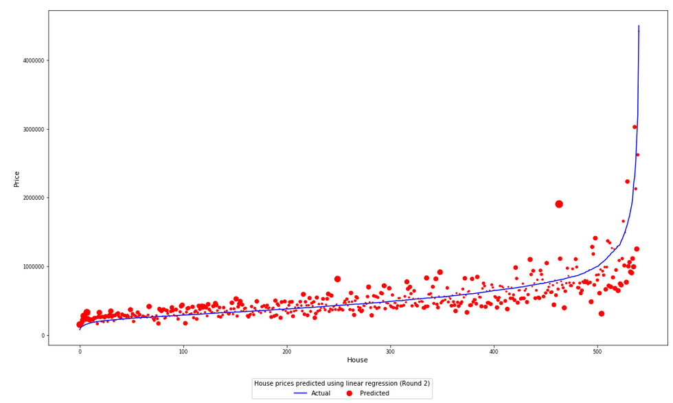
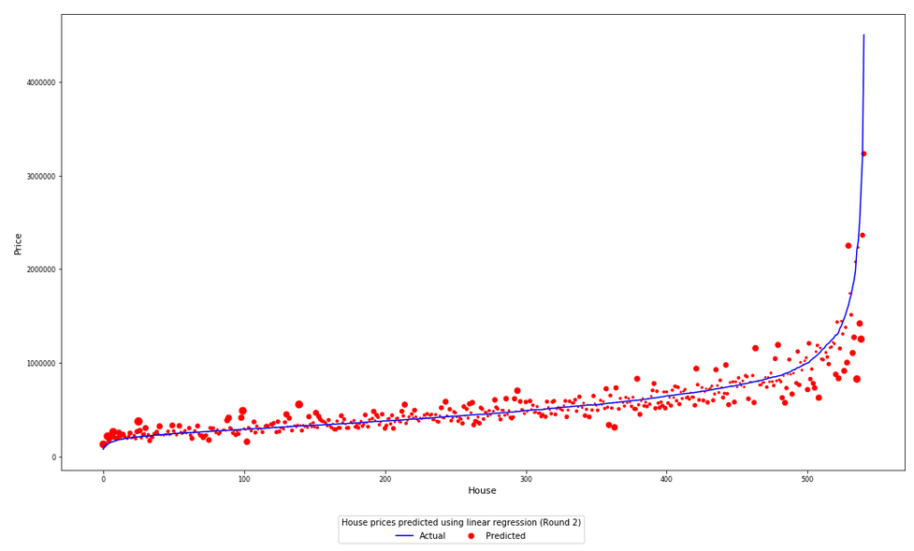
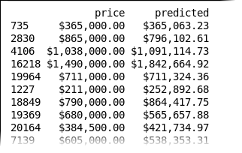
Improved Predictions
Linear Regression Round 2
Random Forest

Slide 36
What strategies might you employ when determining which algorithm you'll use initially?
What concerns do you have about bias in your own datasets?

